Slide 1
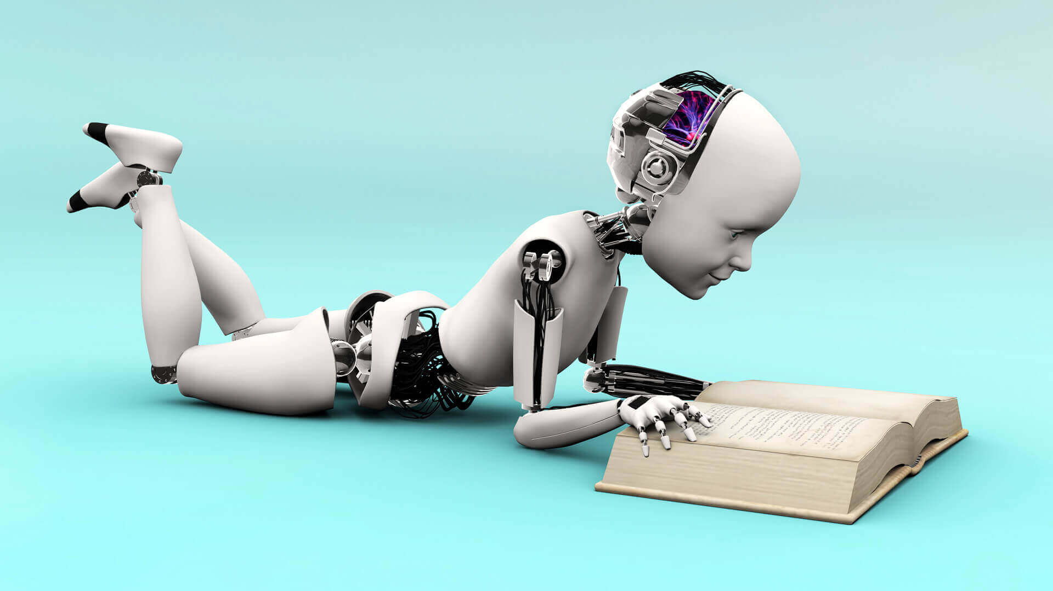



Mod-1
Introduction to Machine Learning
kirtiswagat@outlook.com
https://www.linkedin.com/in/kirtiswagatmohanty/
@kirtiswagat

Slide 2

Learning Objective
M-1 Introduction to ML
You can define following:
What is Machine Learning?
Why Machine Learning is needed?
What are the terminologies used for Machine Learning?
What are the types of Machine Learning?

Slide 3
Machine Learning?
M-1 Introduction to ML
It’s a subset of Artificial Intelligence.
It’s the science and art of programming computers so that they can learn from data.
It’s a technique where predictions about some event can be possible based on some experience which is data in case of machines.
It’s a science of making computers learn and act like humans by feeding data and information without being explicit being programmed.

Slide 4
M-1 Introduction to ML
AI vs Machine Learning vs Deep Learning
A technique which enables machines to mimic human behaviour.
Artificial Intelligence
Sub-set of AI which use statistical methods to enable machines to improve with experience
Machine Learning
Sub-set of ML which make the computational of multi-layer neural network feasible
Deep Learning

Slide 5
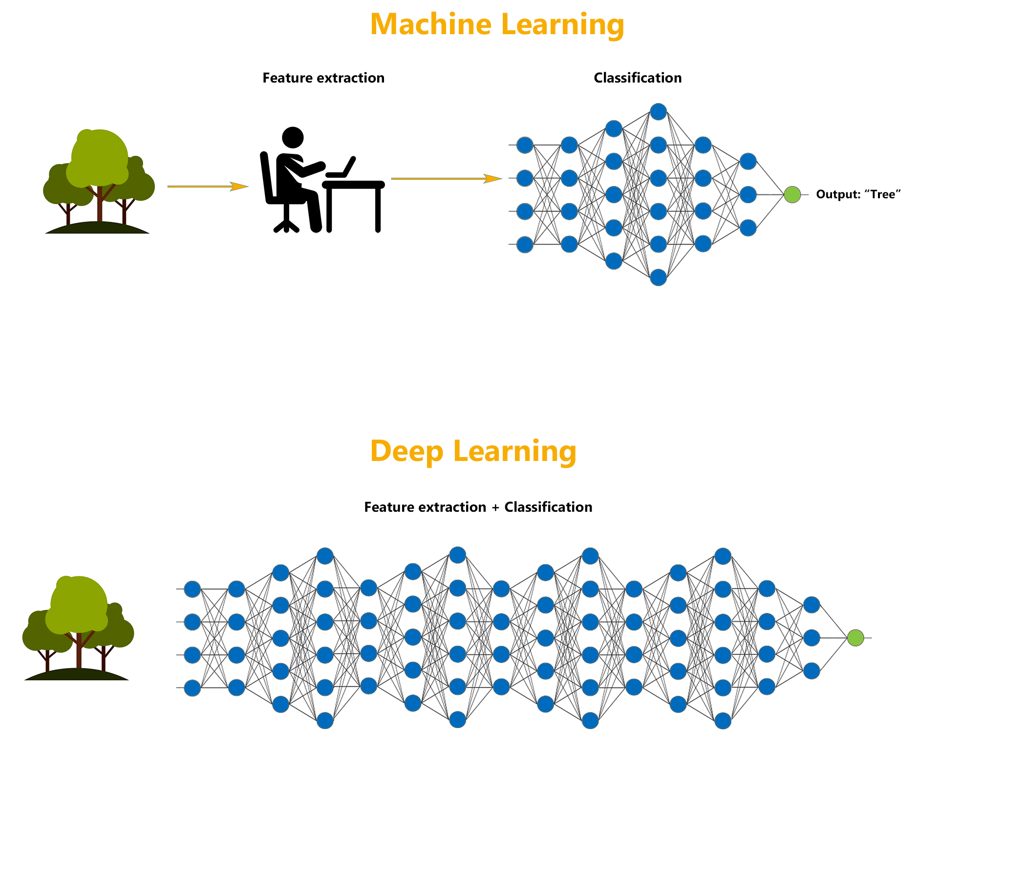
Machine Learning vs Deep Learning
M-1 Introduction to ML

Slide 6
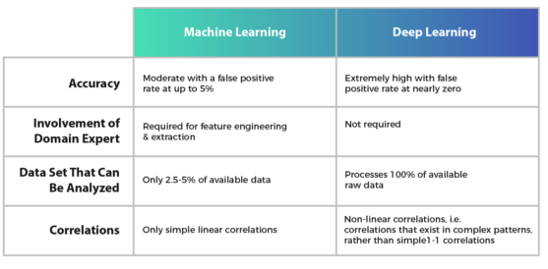
Machine Learning vs Deep Learning
M-1 Introduction to ML

Slide 7
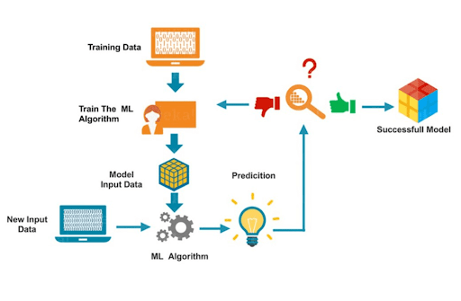
How ML Works?
M-1 Introduction to ML
A

Slide 8



Types of ML
M-1 Introduction to ML
Supervised Learning
Unsupervised Learning
Reinforcement Learning

Slide 9




Supervised Learning Types
M-1 Introduction to ML
Regression
Classification
Notes:
Types of Data- Supervised Learning: Labelled Data
Training Phase :
1. Well Defined with Input and Output
2. Machine is fed with Data
3. Algorithm has to map Input and Output and learn it.
4. Training Data acts like a Guide or Teacher.
5. On completion of Training the Model is tested with Test Data.
Aim:
1. To forecast an Output

Slide 10
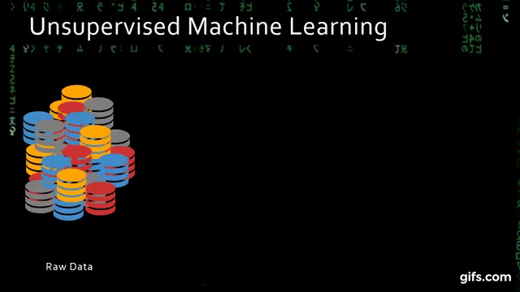
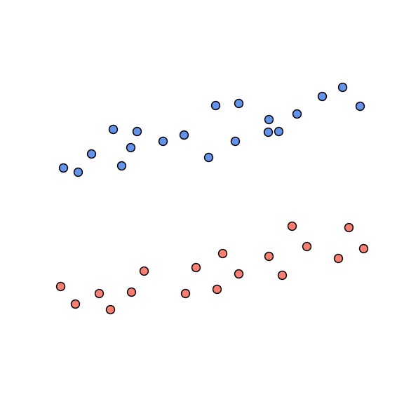
Unsupervised Learning Types
M-1 Introduction to ML
Clustering
Dimensionality Reduction
Notes:
Types of Data- Supervised Learning: Unlabeled Data
Training Phase :
1. Machine is fed with only Input, It has to figure out the Output.
2. There is no supervisor or Guide to map Input to Output.
Aim:
To extract the patterns of data.
To extract useful insights from data.
As the algorithm is fed with only data, hence it has to find it’s own way to Output by finding trends and associations in the Input Data.

Slide 11
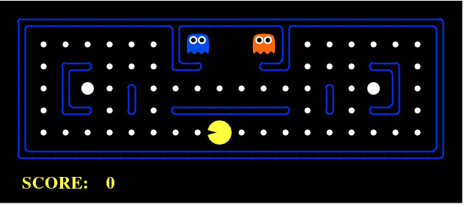
Reinforcement Learning
M-1 Introduction to ML
Notes:
Types of Data- Reinforcement Learning: No Predefined Data
Training Phase :
It’s like a Kid Learning it’s surrounding.
Here Reward and Punishment system is there.
With trial and error system learns or It explores the data

Slide 12
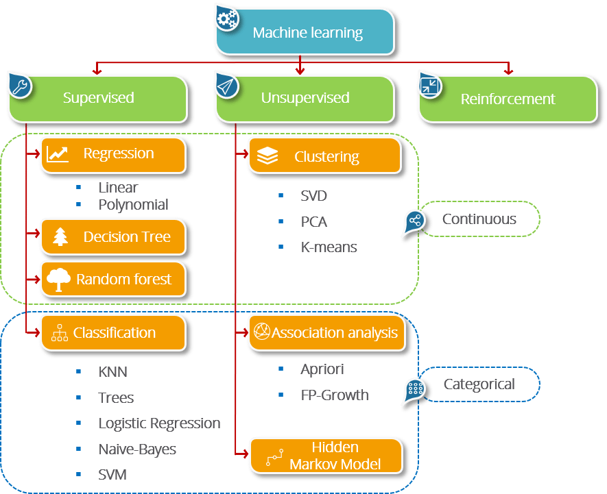
Algorithms
M-1 Introduction to ML
Notes:
Reinforcement Learning:
Q-Learning
SARSA- State Action Reward State Action Algorithm

Slide 13
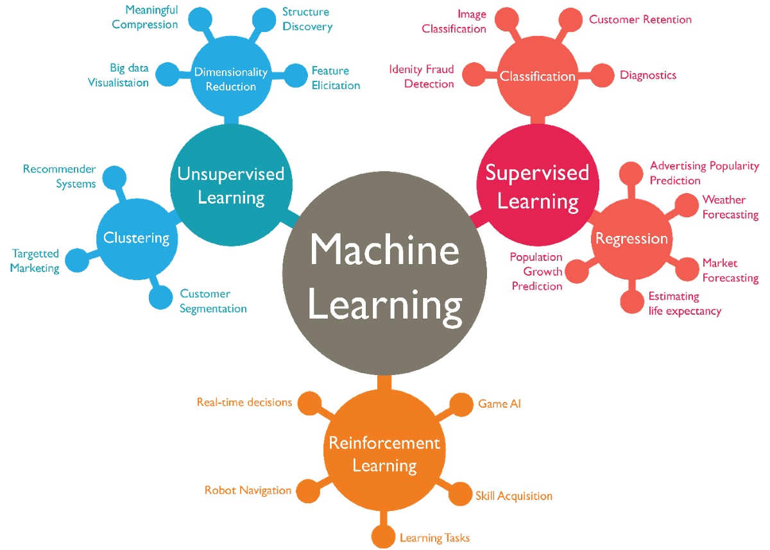
Use Cases
M-1 Introduction to ML

Slide 14
Challenges
M-1 Introduction to ML
Quality of Data
Time-Consuming Task
Lack of Domain Knowledge People
No Clear Objective for formulating business problem
Issue of Overfitting & Under fitting
Curse of dimensionality
Difficulty in deployment
Notes:
Quality of data − Having good-quality data for ML algorithms is one of the biggest challenges. Use of low-quality data leads to the problems related to data preprocessing and feature extraction.
Time-Consuming task − Another challenge faced by ML models is the consumption of time especially for data acquisition, feature extraction and retrieval.
Lack of specialist persons − As ML technology is still in its infancy stage, availability of expert resources is a tough job.
No clear objective for formulating business problems − Having no clear objective and well-defined goal for business problems is another key challenge for ML because this technology is not that mature yet.
Issue of overfitting & underfitting − If the model is overfitting or underfitting, it cannot be represented well for the problem.
Curse of dimensionality − Another challenge ML model faces is too many features of data points. This can be a real hindrance.
Difficulty in deployment − Complexity of the ML model makes it quite difficult to be deployed in real life.

Slide 15
Thank You
M-1 Introduction to ML
kirtiswagat@gmail.com
https://www.linkedin.com/in/kirtiswagatmohanty/
@kirtiswagat

